Slide 1
AI Fundamentals for Non-Data Scientists
AI for Business Introduction
Kartik Hosanagar, Professor of Operations, Information and Decisions

Slide 2
AI and Business
Artificial intelligence (AI) is about getting computers to do things that require human intelligence
Understanding language
Reasoning
Navigating the physical world
Learning
Machine learning - focused on getting computers to learn without explicitly programming them
AI is increasingly being seen as the next phase of digital transformation

Slide 3
Digital Transformation Timeline
Multiple digital technologies have helped transform business
Companies that were slow to react paid the price
Internet
Cloud Computing
Mobile Computing
AI
Late 1990s
Mid 2000s
Late 2000s
Now
AI is likely to be equally transformative and can potentially be viewed as a general-purpose technology

Slide 4
What are General-Purpose Technologies (GPTs)?
GPTs are “characterized by the potential for pervasive use in a wide range of sectors and by their technological dynamism” (Bresnahan & Trajtenberg)
GPTs stimulate innovation and economic growth
GPTs inform products strategy & organizational design/strategy
3 factors can indicate that a new technology shows promise as a GPT:
Widespread use of the technology across many industries
High volume of research jobs related to the technology
Research jobs widespread across many industries
Content/quotes from: “Could Machine Learning Be a General-Purpose Technology? Evidence from Online Job Postings” by Goldfarb, Taska & Teodoridis. Note: the Bresnahan & Tajtenberg quote is from the above paper. The authors of that paper had quoted this definition from Bresnahan & Tajtenberg

Slide 5
How Does AI Show Promise as a GPT?
Research by Goldfarb et al (2019)
Technology | Total Jobs | Total Research Jobs | Percent Research Jobs
Machine Learning | 370,572 | 5715000% | 14.6%
GIS Software | 142,645 | 899300% | 5.8%
CRISPR | 6,716 | 525000% | 78.4%
Quantum Computing | 6,355 | 134800% | 17.4%
Fracking | 2,957 | 14100% | 2.8%
Robotics | 284,474 | 2244800% | 7.3%
Nanotechnology | 4,883 | 251900% | 46%
Internet-of-things | 124,506 | 575000% | 4.3%
Cloud Computing | 1,415,289 | 2939200% | 2.2%
High volume of jobs and research jobs
Research jobs are a particularly important indicator of GPTs because they demonstrate that a technology is “capable of ongoing improvement” and could have significant future potential, beyond what is currently recognized
Content/quotes from: “Could Machine Learning Be a General-Purpose Technology? Evidence from Online Job Postings” by Goldfarb, Taska & Teodoridis.

Slide 6
ML’s Promise as a GPT (cont.)
Jobs widespread across industries
Industry NAICS2 | AI | GIS | Quantum | Fracking | Robotics | Nanotech | IoT | CRISPR | Cloud | Total
Accommodation and Food Services | 5,389 | 883 | 4 | 5 | 1,516 | 5 | 828 | 2 | 15,090 | 5,594,113
Admin & Support & Waste Mgmt & Remediation Srvcs. | 4,142 | 2,099 | 0 | 75 | 2,363 | 6 | 1,836 | 9 | 26,763 | 2,237,225
Agriculture, Forestry, Fishing and Hunting | 820 | 1,388 | 0 | 3 | 384 | 0 | 146 | 0 | 2,310 | 97,644
Arts, Entertainment and Recreation | 437 | 917 | 0 | 2 | 925 | 7 | 109 | 0 | 2,591 | 578,889
Construction | 335 | 2,406 | 1 | 45 | 2,330 | 22 | 361 | 0 | 3,709 | 850,081
Educational Services | 12,467 | 6,836 | 246 | 62 | 10,868 | 1,764 | 1,503 | 1,384 | 17,848 | 4,018,454
Finance and Insurance | 40,261 | 3,871 | 26 | 32 | 7,809 | 7 | 4,569 | 35 | 98,700 | 5,787,861
Health Care and Social Assistance | 102,401 | 34,512 | 158 | 612 | 114,965 | 734 | 28,477 | 1,793 | 481,770 | 38,700,000
Information | 32,613 | 4,483 | 189 | 26 | 6,213 | 85 | 17,079 | 2 | 130,353 | 2,229,564
Management of Companies and Enterprises | 348 | 302 | 0 | 4 | 160 | 2 | 108 | 0 | 1,156 | 80,359
Manufacturing | 37,215 | 7,738 | 257 | 144 | 73,053 | 582 | 24,472 | 1,733 | 96,368 | 6,307,396
Mining | 674 | 1,098 | 0 | 828 | 489 | 2 | 257 | 0 | 1,736 | 216,880
Other Services (except Public Administration) | 1,614 | 1,695 | 0 | 77 | 2,314 | 12 | 181 | 5 | 5,786 | 1,120,323
Professional, Scientific, & Technical Services | 97,704 | 39,478 | 5,403 | 395 | 36,715 | 1,550 | 33,912 | 1,683 | 435,035 | 7,333,834
Public Administration | 4,838 | 21,175 | 41 | 29 | 3,467 | 70 | 680 | 46 | 13,446 | 2,448,184
Real Estate Rental and Leasing | 2,086 | 3,302 | 5 | 16 | 3,815 | 0 | 500 | 1 | 8,000 | 1,293,048
Retail Trade | 21,705 | 1,220 | 14 | 132 | 11,214 | 21 | 5,917 | 2 | 54,247 | 8,720,486
Transportation and Warehousing | 3,411 | 2,639 | 1 | 398 | 2,803 | 6 | 1,236 | 2 | 11,433 | 4,668,538
Utilities | 801 | 3,896 | 0 | 51 | 886 | 6 | 493 | 1 | 2,877 | 333,522
Wholesale Trade | 1,311 | 2,680 | 10 | 21 | 2,185 | 2 | 1,842 | 18 | 6,071 | 620,793
Total | 370,572 | 142,645 | 6,355 | 2,957 | 284,474 | 4,883 | 124,506 | 6,716 | 1,415,289 | 93,237,194
High volume of jobs and research jobs
Table A3.1. Number of jobs in data by industry and technology (2015-2018)
Research by Goldfarb et al (2019)

Slide 7
ML’s Promise as a GPT (cont.)
Jobs widespread across industries
Industry NAICS2 | AI | GIS | Quantum | Fracking | Robotics | Nanotech | IoT | CRISPR | Cloud | Total
Accommodation and Food Services | 5,389 | 883 | 4 | 5 | 1,516 | 5 | 828 | 2 | 15,090 | 5,594,113
Admin & Support & Waste Mgmt & Remediation Srvcs. | 4,142 | 2,099 | 0 | 75 | 2,363 | 6 | 1,836 | 9 | 26,763 | 2,237,225
Agriculture, Forestry, Fishing and Hunting | 820 | 1,388 | 0 | 3 | 384 | 0 | 146 | 0 | 2,310 | 97,644
Arts, Entertainment and Recreation | 437 | 917 | 0 | 2 | 925 | 7 | 109 | 0 | 2,591 | 578,889
Construction | 335 | 2,406 | 1 | 45 | 2,330 | 22 | 361 | 0 | 3,709 | 850,081
Educational Services | 12,467 | 6,836 | 246 | 62 | 10,868 | 1,764 | 1,503 | 1,384 | 17,848 | 4,018,454
Finance and Insurance | 40,261 | 3,871 | 26 | 32 | 7,809 | 7 | 4,569 | 35 | 98,700 | 5,787,861
Health Care and Social Assistance | 102,401 | 34,512 | 158 | 612 | 114,965 | 734 | 28,477 | 1,793 | 481,770 | 38,700,000
Information | 32,613 | 4,483 | 189 | 26 | 6,213 | 85 | 17,079 | 2 | 130,353 | 2,229,564
Management of Companies and Enterprises | 348 | 302 | 0 | 4 | 160 | 2 | 108 | 0 | 1,156 | 80,359
Manufacturing | 37,215 | 7,738 | 257 | 144 | 73,053 | 582 | 24,472 | 1,733 | 96,368 | 6,307,396
Mining | 674 | 1,098 | 0 | 828 | 489 | 2 | 257 | 0 | 1,736 | 216,880
Other Services (except Public Administration) | 1,614 | 1,695 | 0 | 77 | 2,314 | 12 | 181 | 5 | 5,786 | 1,120,323
Professional, Scientific, & Technical Services | 97,704 | 39,478 | 5,403 | 395 | 36,715 | 1,550 | 33,912 | 1,683 | 435,035 | 7,333,834
Public Administration | 4,838 | 21,175 | 41 | 29 | 3,467 | 70 | 680 | 46 | 13,446 | 2,448,184
Real Estate Rental and Leasing | 2,086 | 3,302 | 5 | 16 | 3,815 | 0 | 500 | 1 | 8,000 | 1,293,048
Retail Trade | 21,705 | 1,220 | 14 | 132 | 11,214 | 21 | 5,917 | 2 | 54,247 | 8,720,486
Transportation and Warehousing | 3,411 | 2,639 | 1 | 398 | 2,803 | 6 | 1,236 | 2 | 11,433 | 4,668,538
Utilities | 801 | 3,896 | 0 | 51 | 886 | 6 | 493 | 1 | 2,877 | 333,522
Wholesale Trade | 1,311 | 2,680 | 10 | 21 | 2,185 | 2 | 1,842 | 18 | 6,071 | 620,793
Total | 370,572 | 142,645 | 6,355 | 2,957 | 284,474 | 4,883 | 124,506 | 6,716 | 1,415,289 | 93,237,194
High volume of jobs and research jobs
Table A3.1. Number of jobs in data by industry and technology (2015-2018)
Research by Goldfarb et al (2019)

Slide 8
ML’s Promise as a GPT (cont.)
Research jobs also widespread across industries
Industry NAICS2 | AI | GIS | Quantum | Fracking | Robotics | Nanotech | IoT | CRISPR | Cloud | Total
Accommodation and Food Services | 438 | 24 | 1 | 0 | 43 | 2 | 32 | 2 | 214 | 13,410
Admin & Support & Waste Mgmt & Remediation Srvcs. | 506 | 56 | 0 | 3 | 69 | 1 | 55 | 9 | 472 | 16,768
Agriculture, Forestry, Fishing and Hunting | 243 | 220 | 0 | 0 | 24 | 0 | 6 | 0 | 130 | 9,847
Arts, Entertainment and Recreation | 51 | 110 | 0 | 0 | 12 | 4 | 10 | 0 | 57 | 7,823
Construction | 53 | 76 | 0 | 0 | 68 | 1 | 13 | 0 | 69 | 6,204
Educational Services | 3,991 | 1,785 | 71 | 14 | 1,979 | 682 | 139 | 1,095 | 1,023 | 267,403
Finance and Insurance | 6,409 | 271 | 15 | 3 | 309 | 2 | 249 | 29 | 2,132 | 114,244
Health Care and Social Assistance | 11,974 | 1,905 | 63 | 21 | 8,186 | 366 | 895 | 1,393 | 7,299 | 1,078,322
Information | 6,148 | 144 | 19 | 0 | 584 | 21 | 404 | 1 | 3,383 | 53,490
Management of Companies and Enterprises | 42 | 7 | 0 | 0 | 6 | 0 | 9 | 0 | 19 | 1,061
Manufacturing | 7,682 | 382 | 103 | 35 | 6,024 | 248 | 1,598 | 1,363 | 3,306 | 357,069
Mining | 108 | 51 | 0 | 25 | 34 | 1 | 70 | 0 | 37 | 4,251
Other Services (except Public Administration) | 273 | 162 | 0 | 3 | 102 | 2 | 3 | 0 | 104 | 15,440
Professional, Scientific, & Technical Services | 13,595 | 1,423 | 1,048 | 23 | 3,704 | 1,134 | 1,798 | 1,305 | 8,845 | 391,943
Public Administration | 728 | 1,544 | 17 | 5 | 401 | 33 | 55 | 37 | 287 | 149,862
Real Estate Rental and Leasing | 371 | 544 | 2 | 1 | 83 | 0 | 30 | 0 | 193 | 9,976
Retail Trade | 3,599 | 129 | 9 | 2 | 570 | 14 | 290 | 2 | 1,470 | 35,200
Transportation and Warehousing | 643 | 98 | 0 | 1 | 95 | 1 | 27 | 1 | 188 | 13,639
Utilities | 99 | 28 | 0 | 5 | 29 | 5 | 19 | 0 | 36 | 5,762
Wholesale Trade | 197 | 34 | 0 | 0 | 126 | 2 | 48 | 13 | 128 | 16,492
Total | 57,150 | 8,993 | 1,348 | 141 | 22,448 | 2,519 | 5,750 | 5,250 | 29,392 | 2,568,206
High volume of jobs and research jobs
Table A3.2. Number of research jobs in data by industry and technology (2015-2018)
Research by Goldfarb et al (2019)

Slide 9
AI and Business
AI (specifically ML) shows early indicators of being a general-purpose technology
Implications for firms if ML is a GPT:
Realize that most industries are likely to change
Be patient: the transformative impact may come with a lag
To effectively leverage the opportunities, managers need to understand the technology and its applications, and make changes to their “business models, technology infrastructure, organizational processes, and culture”
Content from: “Could Machine Learning Be a General-Purpose Technology? Evidence from Online Job Postings” by Goldfarb, Taska & Teodoridis
Content/Quote from: https://www.simplilearn.com/introduction-to-digital-transformation-tutorial

Slide 10
AI Fundamentals for Non-Data Scientists
Course Introduction
Kartik Hosanagar, Professor of Operations, Information and Decisions

Slide 11
Course Introduction
This course will discuss AI Fundamentals from a business perspective
Introduction to Big Data
Introduction to Artificial Intelligence (AI)
Machine Learning (ML) in Practice
Building AI Systems Without Data

Slide 12
AI Fundamentals for Non-Data Scientists
Big Data Overview
Kartik Hosanagar, Professor of Operations, Information and Decisions

Slide 13
Agenda for Module 1
Big Data Overview
What big data is, how it is being generated, and why it matters
Big Data Analysis
Approach to analysis, analytics competencies, and broad skillset needs
Big Data Tools
Data management tools and data analysis tools
Extracting Intelligence from Big Data
Predictive analytics and implications for business strategy

Slide 14
“
Data is the new Oil. Data is just like crude. It’s valuable, but if unrefined it cannot really be used.”
— CLIVE HUMBY

Slide 15
“
We have for the first time an economy based on a key resource [Information] that is not only renewable, but self-generating. Running out of it is not a problem, but drowning in it is.”
— JOHN NAISBITT

Slide 16
What is Big Data?
Data has been very important to businesses for multiple decades, but the emphasis on big data is relatively new
Data that “exceeds the capacity or capability of…conventional methods and systems” (National Institute of Standards and Technology)
Big data is not only about volume of data, it is also about:
The structure of the data set
The speed at which it is created
The tools you need to analyze it
What you can do with the data set
Quote from: https://www.technologyreview.com/s/519851/the-big-data-conundrum-how-to-define-it/
Additional content from: “Big Data” by Victor Mayer- Schonberger and Kenneth Cukier and https://www.sas.com/en_us/insights/big-data/what-is-big-data.html

Slide 17
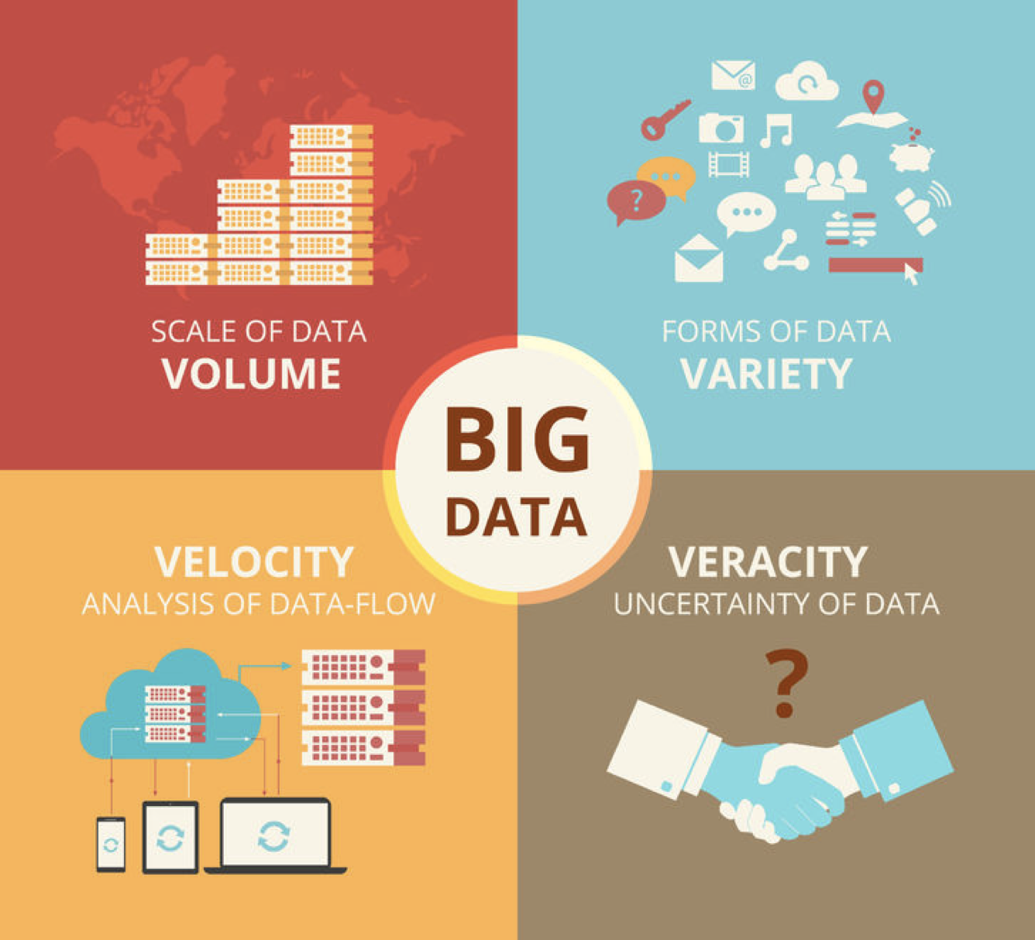
Big Data Characteristics
New data characteristics created by today’s digitized marketplace
“Terabytes to petabytes of existing data to process”
“Structured, unstructured, text, multimedia”
“Streaming data, milliseconds to seconds to respond"
“Uncertainty due to data inconsistency & incompleteness, ambiguities, latency, deception, model approximations”
Image from: https://www.cbpr.me/big-data-and-public-relations/4vs/
Additional quotes from another diagram found at https://www.datasciencecentral.com/profiles/blogs/data-veracity

Slide 18
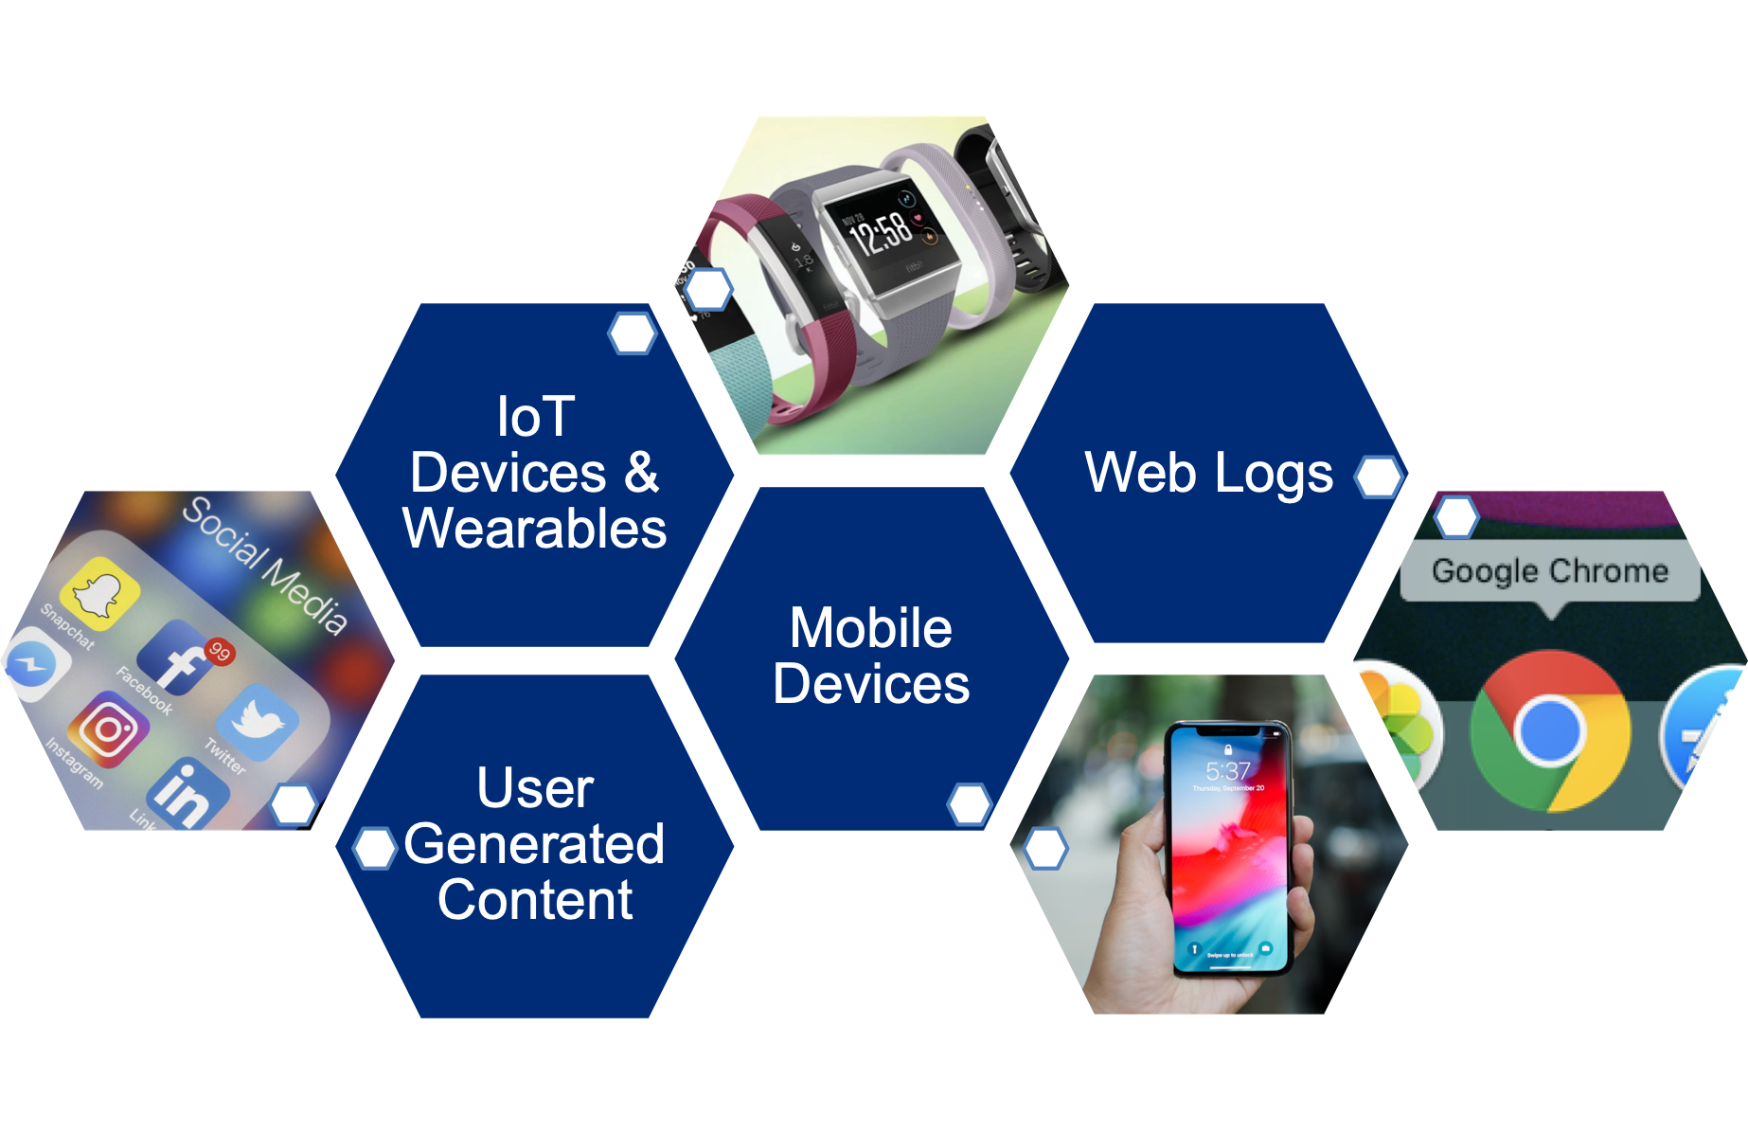
Drivers of Big Data
Computing capacity: the capacity to store data has increased and the associated cost has decreased
Data generation: the world is going digital, more people and things are connected than ever before
Content/quotes from: “Big Data” by Victor Mayer- Schonberger and Kenneth Cukier, Images: https://www.axios.com/fewer-people-use-facebook-for-news-13273e71-ab51-49cc-b4ee-1588a241c0c8.html, https://www.imore.com/best-fitbit, https://www.digitaltrends.com/cell-phone-reviews/apple-iphone-xs-review/

Slide 19
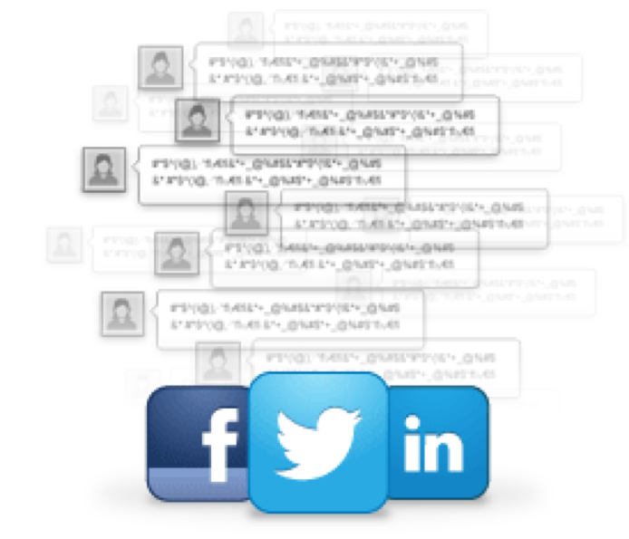

Drivers of Big Data
Big data allows you to:
1. Ask new questions
2. Answer same questions better
This can be done across industries
Healthcare, education, transportation, and more
Content/quotes from: “Big Data” by Victor Mayer- Schonberger and Kenneth Cukier

Slide 20
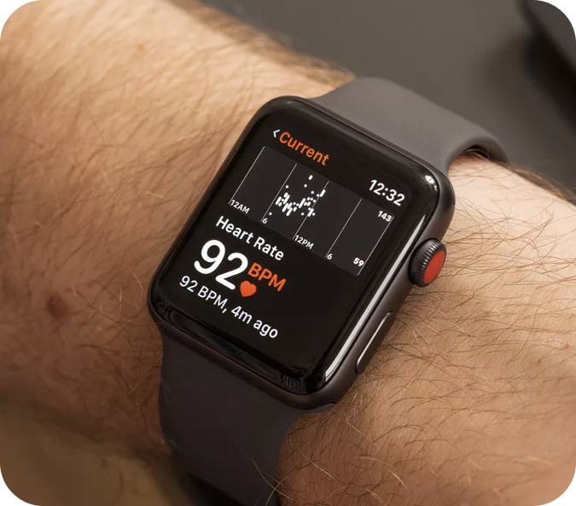
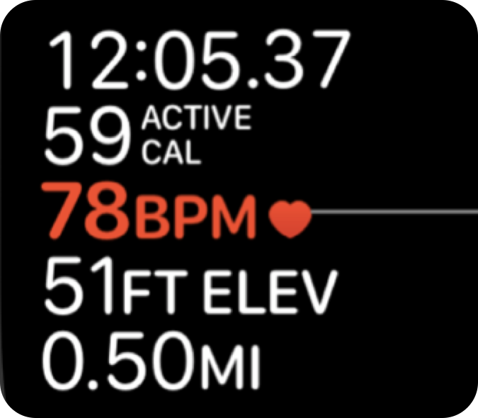
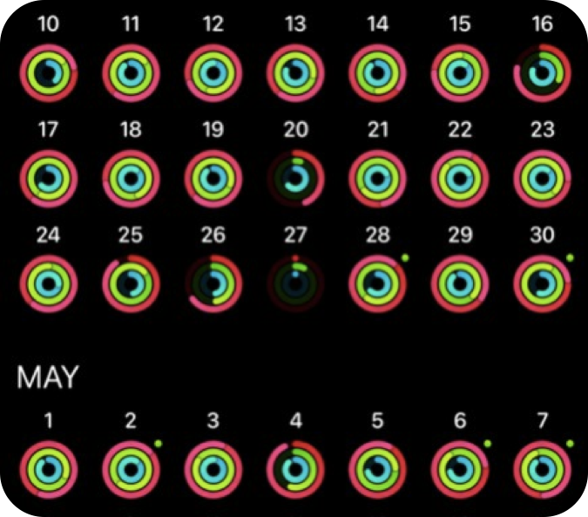
Big Data in Healthcare
Big Data
Result
Data about heart rate, sleep quality, exercise and more
Improves tracking of health patterns
Gathered continuously and available in real time
Availability
Content/quote from: https://intellipaat.com/blog/7-big-data-examples-application-of-big-data-in-real-life/, Images: https://support.apple.com/guide/watch/heart-rate-apda88aefe4c/watchos, https://www.theverge.com/2017/11/30/16719458/apple-watch-study-irregular-heart-rhythms-stanford-university, https://www.wareable.com/apple/apple-watch-activity-and-workout-app-explained-875

Slide 21
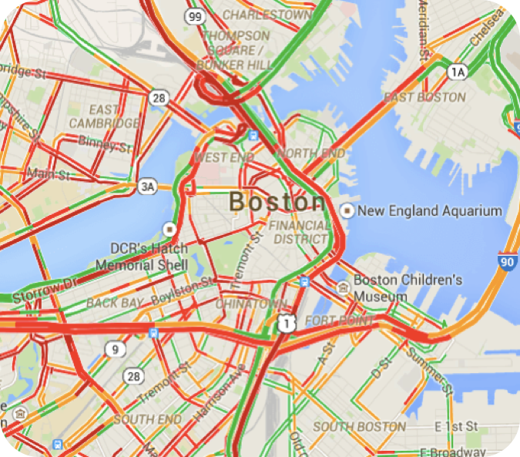
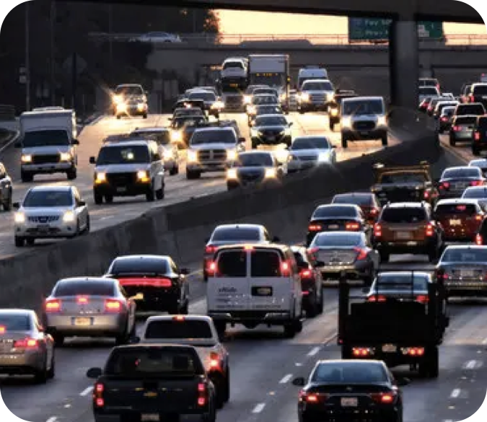
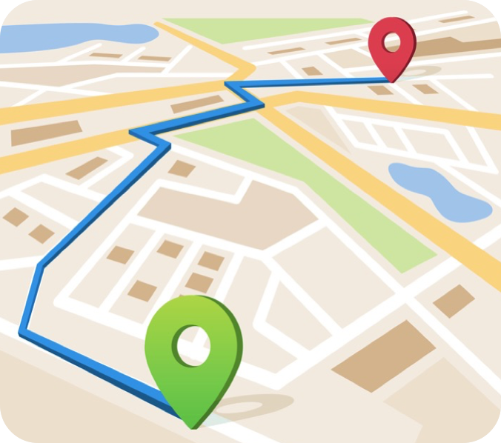
Big Data in Transportation
Big Data
Result
Data about traffic, road closures, accidents, etc.
Allows for better route planning and scheduling
Available in a visual format in real time
Availability
Content/quote from: https://intellipaat.com/blog/7-big-data-examples-application-of-big-data-in-real-life/, Images: https://www.nytimes.com/2019/01/21/upshot/stuck-and-stressed-the-health-costs-of-traffic.html, https://medium.com/@imtechpros_87395/where-does-google-maps-get-its-traffic-data-from-2562f984d82f, https://www.developerlibs.com/2018/08/flutter-how-can-draw-route-on-google.html

Slide 22
AI Fundamentals for Non-Data Scientists
Big Data Analysis
Kartik Hosanagar, Professor of Operations, Information and Decisions

Slide 23


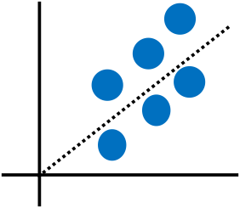
Big Data Approach to Analysis
Traditional Analytics
Big Data Analytics
Structured & Repeatable
Iterative & Exploratory
Question
Hypothesis
Data
Exploration
?
Answer
Data
Actionable Insight
Correlation
Start with hypothesis
Test against selected data
Data leads the way
Explore all data, identify correlations

Slide 24
Big Data Requires a Broad Skillset
Manage the data
Tool Developers
Data Experts: Data architects, governance, policy
Understand the data
Data Science: Statistics, computer science
Visualization Expertise: Interpret data, graph them in meaningful ways
Act on the data
Decision Making - Exec. & Management: Apply data to solve business issues
Industry Vertical Domain Expertise: Identify relevant business issues, ask the right questions

Slide 25
Choosing a Big Data Tool
Two broad categories of big data tools to choose from, depending on whether you are trying to manage the data or analyze it
Data Management Tools
Data Analysis Tools
“Data Mining”
Data Warehouses
Clustering
Hadoop & Spark
Association Rule Mining
Machine Learning

Slide 26
AI Fundamentals for Non-Data Scientists
Data Management Tools
Kartik Hosanagar, Professor of Operations, Information and Decisions

Slide 27
What is a Data Warehouse?
Database
A structured collection of data
Example: an Excel spreadsheet
Database Management System (DBMS)
Allow users to access and manage the database
Example: Excel, Microsoft, Oracle, MongoDB
Often referred to as a database

Slide 28
What is a Data Warehouse?
Data warehouse
A particular kind of DBMS
Specialized in the type of data it stores - historic data from many sources
Specialized in the purpose it serves - analytics
Example: Azure SQL Data Warehouse, Google BigQuery, Snowflake, Amazon Redshift
Content/quotes from: https://www.dremio.com/what-is-a-data-warehouse/

Slide 29
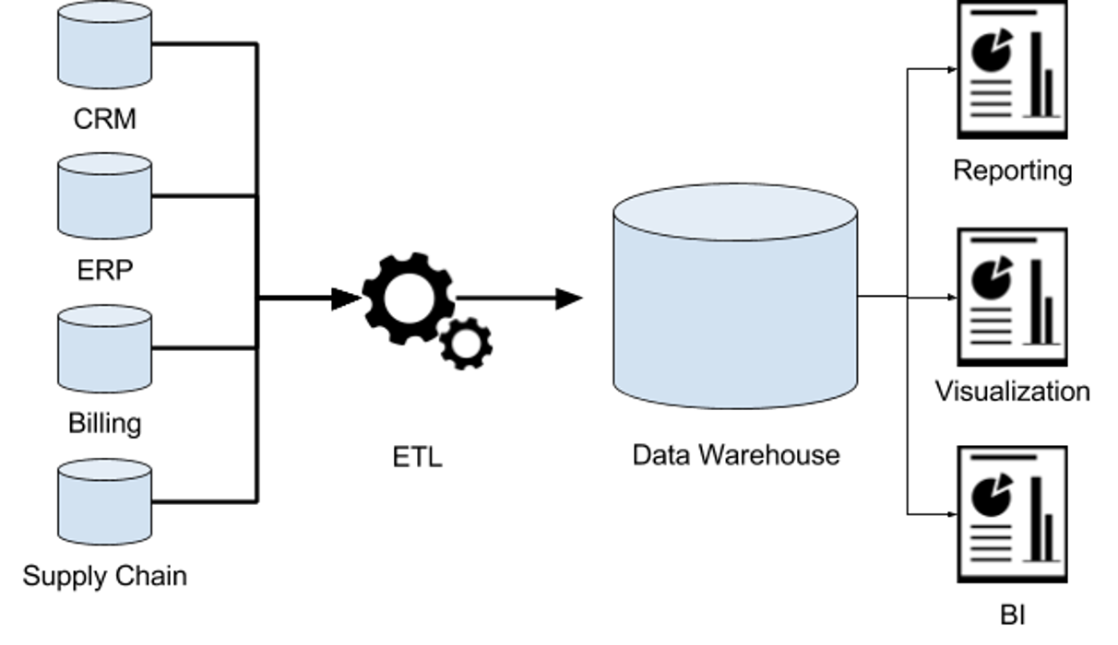
How Do Data Warehouses Work?
Diagram from: https://www.dremio.com/what-is-a-data-warehouse/

Slide 30
Value of a Data Warehouse
A single point of access for data
A history of all the data is stored
Separates operations from analytics
Allows answers to questions like: “How much revenue has each product line brought in per month over the last 10 years, broken out by month, city, and state?”
All information quoted from: https://www.dremio.com/what-is-a-data-warehouse/

Slide 31

Open Source Big Data Tools: Hadoop and Spark
Big data tools like Hadoop serve two main purposes, storage and processing
Storage - lots of data (usually in a distributed fashion)
Processing - involves distributed processing across nodes, parallelizing the data process as much as possible
Popular Hadoop distribution: Cloudera
Content (on 4 steps of Hadoop w/ MapReduce) from: https://hci.stanford.edu/courses/cs448g/a2/files/map_reduce_tutorial.pdf

Slide 32

Open Source Big Data Tools: Hadoop and Spark
Spark is a more recent version of Hadoop
Databricks is the dominant company built around Spark
Content (on 4 steps of Hadoop w/ MapReduce) from: https://hci.stanford.edu/courses/cs448g/a2/files/map_reduce_tutorial.pdf

Slide 33
AI Fundamentals for Non-Data Scientists
Data Management Infrastructure
Kartik Hosanagar, Professor of Operations, Information and Decisions

Slide 34
What is a Data Warehouse?
Database:
“A structured collection of data”
Example: an Excel spreadsheet
Database Management System (DBMS):
“Allows user to access and manage the database”
Examples: Excel, Oracle, MongoDB
Often also referred to as a database
Data Warehouse:
A particular kind of DBMS, “specialized in the data it stores - historic data from many sources - and the purpose it serves - analytics”
Azure SQL Data Warehouse, Google BigQuery, Snowflake, Amazon Redshift
Content/quotes from: https://www.dremio.com/what-is-a-data-warehouse/

Slide 35
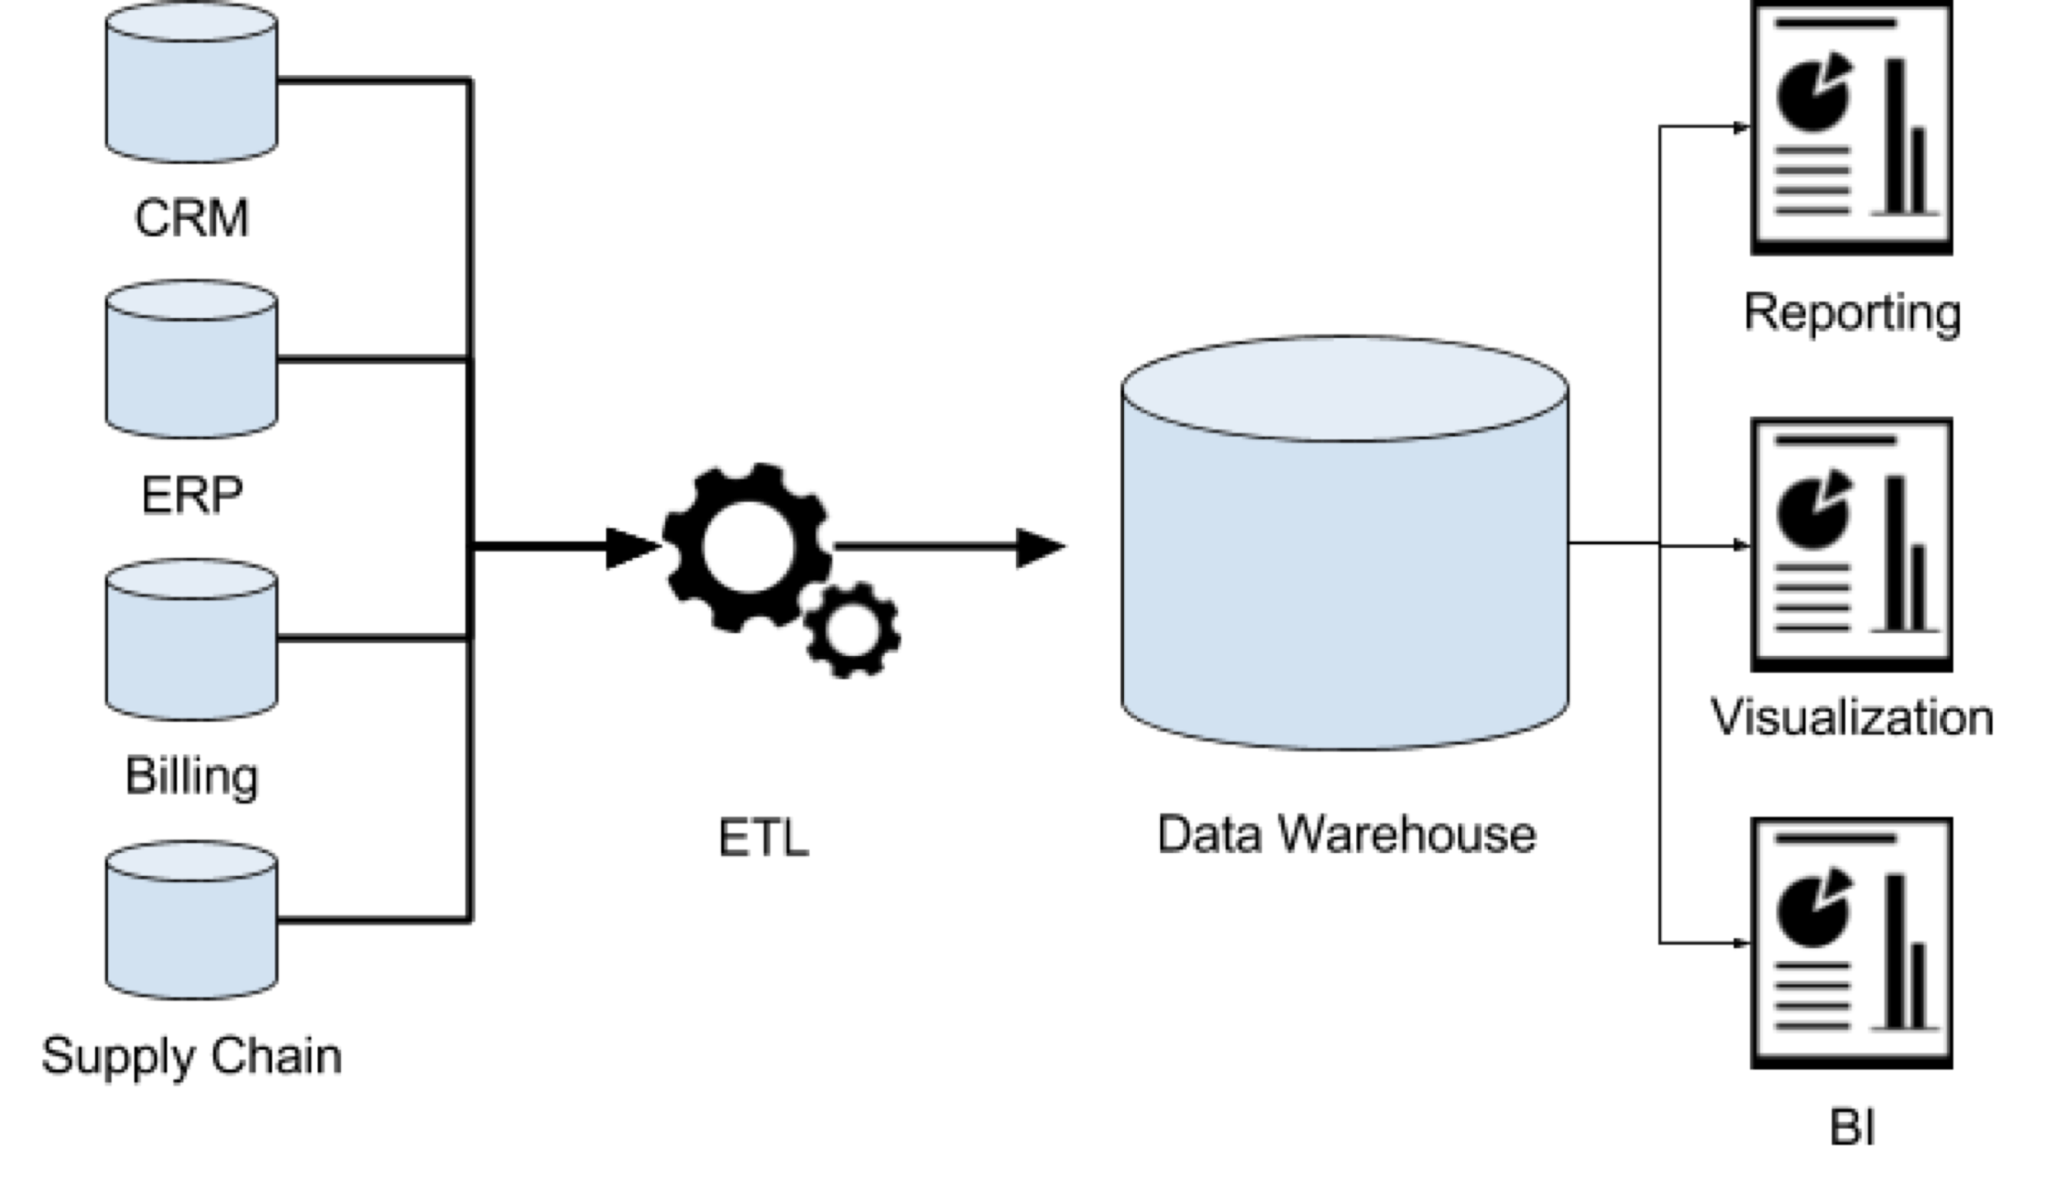
How Do Data Warehouses Work?
Diagram from: https://www.dremio.com/what-is-a-data-warehouse/

Slide 36
Value of Data Warehouses
Data warehouses provide:
Allowing answers to questions like:
“How much revenue has each product line brought in per month over the last 10 years, broken out by city & state?”
“What is the average transaction size at our ATMs, broken out by time of day & customer assets?”
“What is the % employee turnover for the past year in stores that have been open for at least 3 years. How many hours did those employees work per week?”
“A single point of access for data”
“An assurance of data quality”
“A history of the data they store”
“A separation of operations and analytics”
“A standard set of semantics around data”
All information quoted from: https://www.dremio.com/what-is-a-data-warehouse/

Slide 37

What is a Data Warehouse?
Big data tools like Hadoop solve 2 problems:
Storage of lots of data (usually in a distributed manner) - E.g. HDFS
Processing big data, which usually involves (i) distributed processing (1000s of servers), (ii) parallelization - E.g. MapReduce
Example - when you have text from emails, webpages, etc., and you want to count the number of times particular words appear
In this case, Hadoop with MapReduce will:
Split the text into groups sent to different machines
Map each group into pairs (<key, value>)
Shuffle the pairs to group pairs with the same key
Reduce each group of pairs with the same key
Content (on 4 steps of Hadoop w/ MapReduce) from: https://hci.stanford.edu/courses/cs448g/a2/files/map_reduce_tutorial.pdf
Images: https://www.diyotta.com/glossary/what-is-hadoop

Slide 38
AI Fundamentals for Non-Data Scientists
Data Analysis: Extracting Intelligence from Big Data
Kartik Hosanagar, Professor of Operations, Information and Decisions

Slide 39
Data Mining
Term encompassing tools for discovering patterns in large datasets
Data mining vs. regressions?
Representation
Risk = 0.93*prior_default + 0.23*nun_cards – 1.3*employed – 0.734
How did the technique find the relevant variables and coefficients?
Regression: analyst had a hypothesis
Data mining: data-driven exploration
Data mining techniques/tools
Clustering
Association rule mining

Slide 40
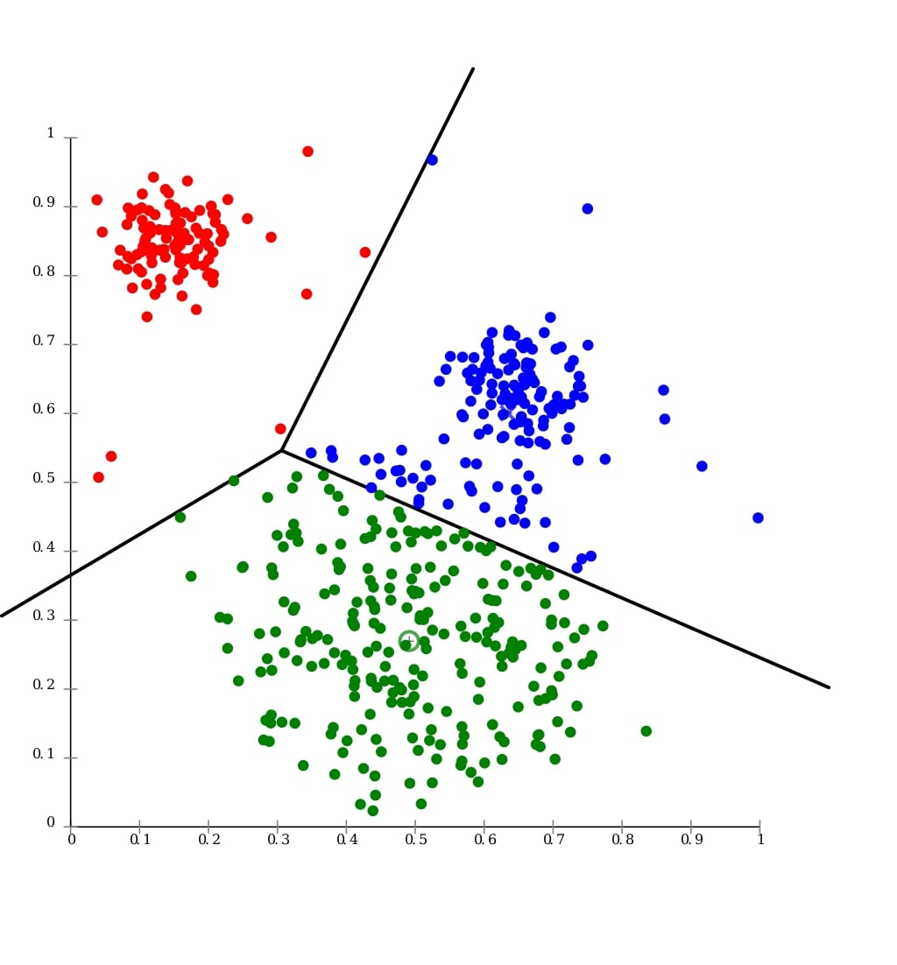
Clustering
Clustering: Grouping data such that intra-group similarity is maximized while inter-group similarity is minimized
Application: Data-driven customer segmentation

Slide 41

Association Rule Mining
Association rule mining - finding common co-occurrences in data
Basket analysis:
{bread, butter} ➜ {milk}
Medical diagnosis: Fish oil and Raynaud’s disease
“Local increase of blood viscosity during cold-induced Raynaud’s phenomenon”
“Reduction in blood viscosity by eicosapentaenoic acid”

Slide 42
From Description to Prediction
Data mining (including clustering and association rule mining) is ultimately about discovering & describing what patterns exist in data
The next step, and the core business opportunity, involves using data to make predictions about the future, called predictive analytics
Can we predict demand?
Can we predict fraud?
Content/quotes from: “Prediction Machines” by Ajay Agrawal, Joshua Gans, and Avi Goldfarb

Slide 43





Predictive Analytics: Amazon Recommendations
Visit website
Shop and place in cart
Pay for items
Items shipped
Amazon’s Recommendations
Content/quotes from: “Prediction Machines” by Ajay Agrawal, Joshua Gans, and Avi Goldfarb, Images: https://www.netsville.com/2018/11/13/amazon-hq2-bringing-25k-jobs-to-2-new-east-coast-locations/amazon-logo-square/, https://icon-library.net/icon/shopping-icon-on-amazon-25.html, https://www.imore.com/amazon-app-everything-you-need-know, https://services.amazon.com/handmade/getting-started-guide.html, https://www.mageplaza.com/blog/product-recomendation-how-amazon-succeeds-with-it.html

Slide 44



Predictive Analytics: Amazon Payments
Items purchased*
Algorithm predicts fraud has occurred
Payment method rejected
*Past data about customer behavior on the site, coupled with knowledge of which previous purchases were fraudulent, helps train the system to make real-time fraud predictions based on customer behavior (this will be discussed further in Module 3)
Content/quotes from: https://stripe.com/radar/guide, Images: https://visualmodo.com/6-security-tips-protect-ecommerce-site/, https://medium.com/@fenjiro/data-mining-for-banking-loan-approval-use-case-e7c2bc3ece3

Slide 45
Implications of Big Data & Predictive Analytics
Big data & predictive analytics have direct benefits for Amazon
Helpful recommendations ➜ more shoppers and purchases
Accurate fraud predictions ➜ fewer losses & happier customers
Perhaps most importantly, prediction can be a virtuous cycle
Better predictions ➜ more shoppers ➜ more data ➜ better predictions
Content/quotes from: “Prediction Machines” by Ajay Agrawal, Joshua Gans, and Avi Goldfarb

Slide 46
AI Fundamentals for Non-Data Scientists
Introduction to Artificial Intelligence
Kartik Hosanagar, Professor of Operations, Information and Decisions

Slide 47
Agenda
Artificial Intelligence (AI) Overview
What AI is, types of AI, history of AI and the expert systems approach
Machine Learning (ML) Overview
How ML differs from AI and the three types of ML (supervised, unsupervised, and reinforcement learning)
Detailed View of ML
ML at 30,000 feet and factors that influence accuracy in ML
Specific ML Methods: A Deep Dive
Logistic regression, decision trees & random forests, and neural networks

Slide 48

What is Artificial Intelligence (AI)?
Definition of AI
“The theory and development of computer systems able to perform tasks that normally require human intelligence” - Merriam Webster
Understanding language, reasoning, speech recognition, decision-making, navigating the visual world, manipulating physical objects, etc.
At its core, AI is about getting computers to do things that require human intelligence.
Images: https://www.securitymagazine.com/articles/90871-whats-the-real-role-of-ai-and-ml-in-cybersecurity

Slide 49
Intelligence on a Spectrum
AI can refer to many different types of intelligence:
Artificial Narrow Intelligence (weak AI):
AI that is very good at one specific task
A chess algorithm that can beat any human
Amazon’s book recommendations
Artificial General Intelligence (strong AI):
A computer program that could do all intelligent things a human could do, just as quickly and easily
Artificial Neural Networks are the closest thing to reaching this level
Artificial Super Intelligence:
A computer program that can rapidly improve itself and do all things a human could do at a significant increase in speed and competency

Slide 50
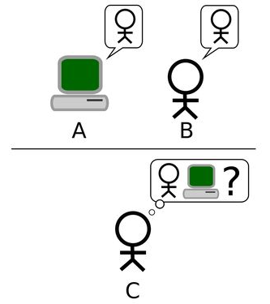
History of AI
Origins
Alan Turing, Cryptography
Can machines think?
“My contention is that machines can be constructed which will simulate the behavior of the human mind very closely.”
Proposed the Turing test for machine intelligence (1950) - Can machines do well in imitation games?
Soon after, a workshop called the Dartmouth Summer Research Project on Artificial Intelligence was held, which historians believe is what coined the term AI
Content/quotes from: “A Human’s Guide to Machine Intelligence” by Kartik Hosanagar

Slide 51
“
Calling it AI made it extremely ambitious, and it inspired many people to enter the field, which has been responsible for a lot of the progress.”
— PEDRO DOMINGOS

Slide 52

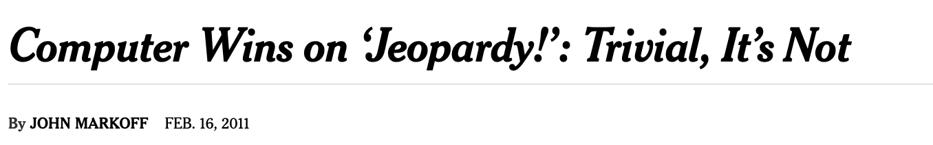
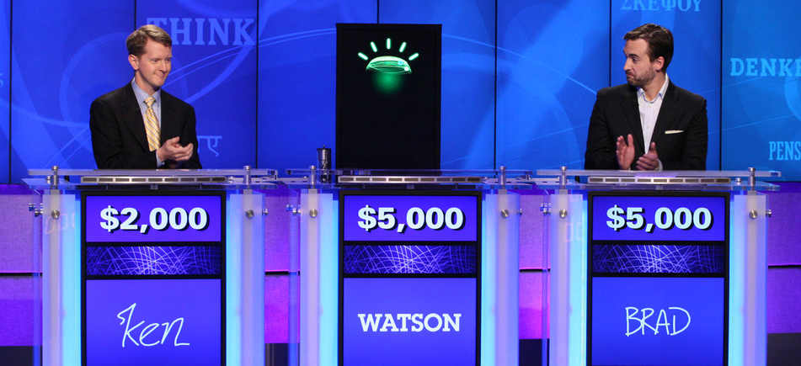
AI in the Press
Much of what the general public knows about AI is about AI playing popular games, which has been widely covered in the press
Images: https://www.nytimes.com/2011/02/17/science/17jeopardy-watson.html

Slide 53
Progression of AI in Games
IBM’s Deep Blue
May 11, 1997 - IBM’s Chess Playing computer beat #1 in the world, Garry Kasparov
No ML in system - Ability to analyze > 200,000 moves per second
IBM’s Watson
2011 - IBM Watson beats Ken Jennings and Brad Rutter (two of Jeopardy’s best)
Using Natural Language Processing (NLP) and Question Answer (QA) information retrieval
Google + DeepMind’s AlphaGo
Wins 4:1 vs. World Champion Lee Sedol in GO
Techniques - Machine Learning (Neural Nets & Reinforcement Learning)

Slide 54



How to Build AI: Expert Systems Approach
Knowledge engineering, or expert systems
Capturing and transferring knowledge from experts to a computer system
Examples:
Software to diagnose diseases - interview doctors and codify the rules they use to diagnose diseases
Software for self-driving cars - interview drivers and codify the rules they use to drive cars
Can create reasonably intelligent systems, but over time expert systems are often not able to beat human beings at complex tasks that require intelligence

Slide 55
How to Build AI: Expert Systems Approach (cont.)
Limitations of expert systems
Polanyi’s Paradox - Tacit knowledge
Idea that we have a lot of knowledge that we are not aware of
Asking people to give us all the knowledge they have gets us a good amount of information, but because of tacit knowledge it doesn’t give us all the information needed
Doctors arrive at diagnoses in seconds based off pattern matching, not rules
Drivers cannot articulate all the rules they use to drive cars
The limitations of the expert systems approach has led to the emergence of a newer approach known as machine learning (ML)

Slide 56
AI Fundamentals for Non-Data Scientists
Machine Learning Overview
Kartik Hosanagar, Professor of Operations, Information and Decisions

Slide 57


What is Machine Learning?
Machine learning (ML) is a subfield of AI
ML methods are characterized by their ability to learn from data without being explicitly programmed
ML is often used for making predictions
PREDICTION TASKS
APPLICATIONS OF ML
Structured Data: “Is a transaction fraudulent?”
Text: “Is an email spam?”
Images: Image recognition in driverless cars
Audio: Speech recognition
Healthcare: Automated medical diagnosis
HR: Which applicants are best suited for a job
Tech: Voice interfaces, Autonomous cars, personalization
Finance: Investing

Slide 58
Three Types of Machine Learning
Supervised
Learning
Unsupervised
Learning
Reinforcement
Learning
Develop predictive model based on input and output data
Group and interpret observations based only on input data
Acquire new data by taking actions and receiving ad hoc feedback
Classification
Anomaly Detection
Bandit Algorithms
Regression
Clustering
Q-learning

Slide 59
Supervised Learning
Idea: Learning from data where you have cleanly labeled outputs and inputs
Inputs can be referred to as features/covariates
Outputs are often called targets (this is what we are trying to predict)
Example - Email data
The output we are trying to predict is whether an email is spam or not
The inputs, or features/covariates, are the actual text in the email
Supervised learning is used when there is cleanly labeled past data, which have a “correct” answer
Certain data have been labeled as “spam”
Certain other data have been labeled as “not spam”

Slide 60
Supervised Learning Example
Concrete example: Tagging text content on Facebook
106,316 Facebook posts submitted by large brands; wanted to identify what types of posts were associated with highest engagement
Manually tagging content is expensive, so we wanted to automate it with a supervised machine learning technique
Solution - have a random sample tagged manually on Amazon Mechanical Turk, and use as a training dataset for supervised ML
Took a sample of 5,000 posts and had human beings label each of these posts
These labels were then used as a training data set for a supervised machine learning algorithm that learned what kinds of words are predictive of whether a post is emotional, or humorous, etc.
That algorithm was used to make predictions for the remaining posts that hadn’t been labeled by a human being

Slide 61
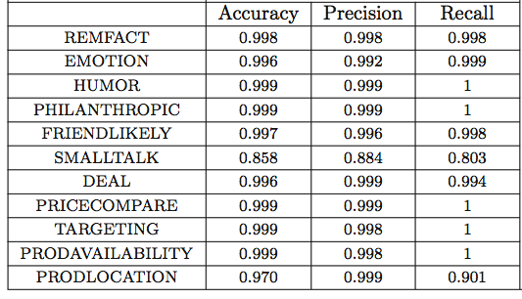
NLP Algorithm Performance
Algorithm described in detail at: https://papers.ssrn.com/sol3/papers.cfm?abstract_id=2290802

Slide 62
Unsupervised Learning
No fixed set of outputs provided; must be learned from inputs
Goal is to cluster and identify important features

Slide 63
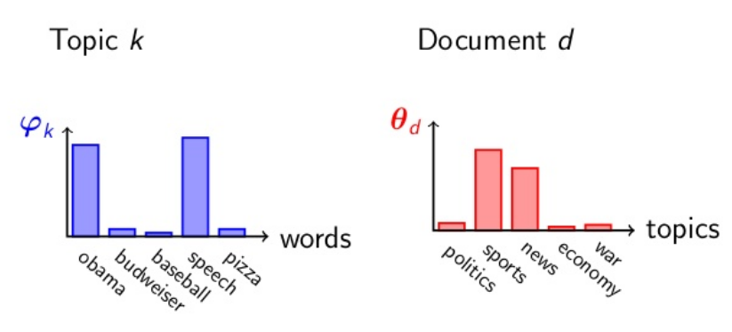
Unsupervised Learning
Latent Dirichlet Allocation (LDA)
Takes as input a set of documents
Identifies both common topics across set of documents
Labels documents with corresponding topics

Slide 64
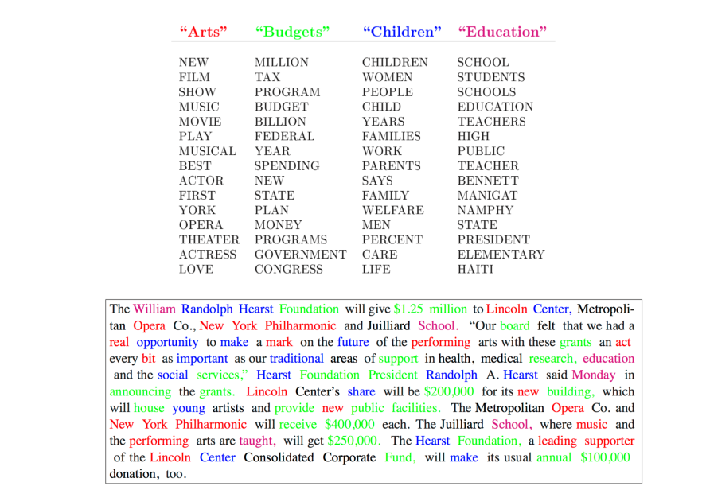
Unsupervised Learning

Slide 65
Reinforcement Learning
Idea: Let algorithms learn by testing various actions/strategies and deciding which one works best
Very powerful method for simulation and robotics-based applications
At the heart of AlphaGo and other state-of-the-art gaming AI
In many applications experimentation isn’t free
You often want to balance both exploration and exploitation
Multi-armed bandit algorithms

Slide 66
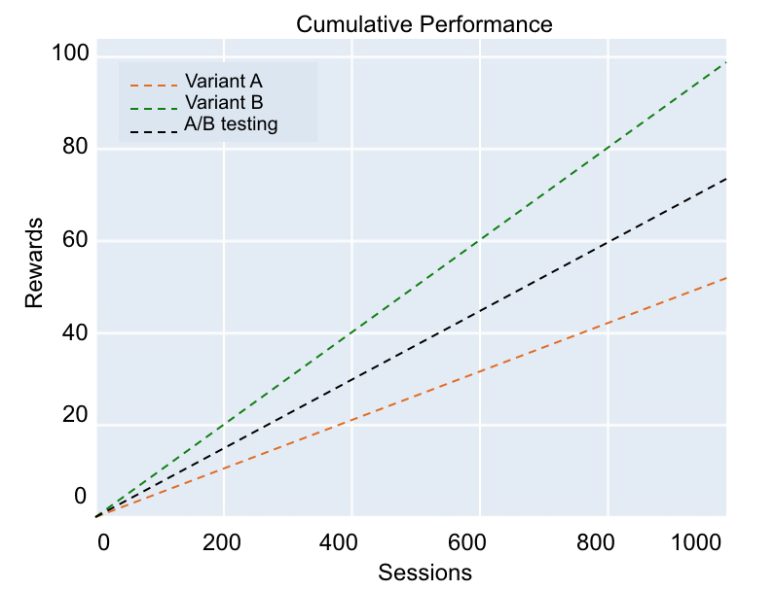
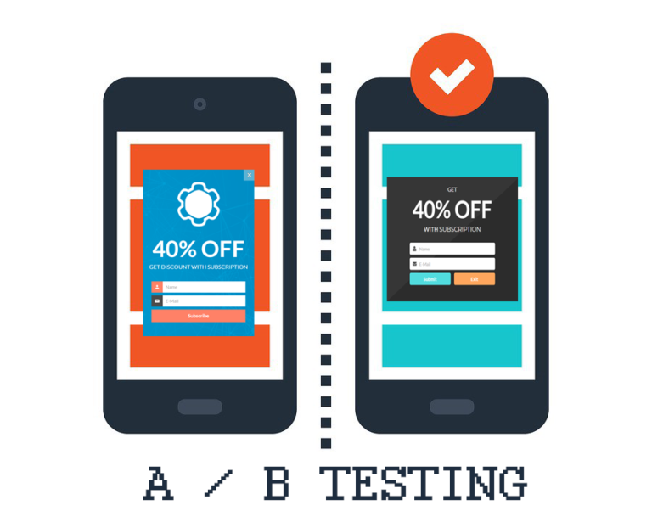
Reinforcement Learning
Suppose you have two ad copies and you don’t know which will attract more clicks (and therefore visitors to your website)
Traditional A/B testing involves showing ad A 50% of the time and ad B 50% of the time, and then assessing which ad performed better
Ad A
Ad B
B performs better than A
The A/B test line is midway between the A and B lines as it is 50% A and 50% B

Slide 67
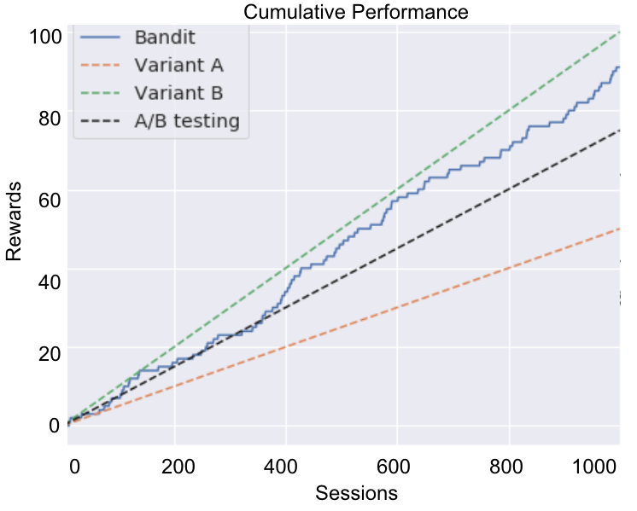
Reinforcement Learning
Machine learning can improve upon A/B testing through bandit algorithms
Bandit algorithms update beliefs based upon performance
They spend more time on best performers early on while still learning and improving over time
The bandit begins by showing 50% A & 50% B, but slowly starts allocating more and more traffic to the higher-performing ad as it learns and confirms which one is better

Slide 68
AI Fundamentals for Non-Data Scientists
Reinforcement Learning
Kartik Hosanagar, Professor of Operations, Information and Decisions

Slide 69


Bandit Algorithms for Website Optimization
Website
“Action” space
Objective
Conversion rate
Revenue per session
E-commerce retailer
Design of product page
Outcome of interest

Slide 70
Exploration and Exploitation
Exploration - gathering more information about the decision environment
Exploitation - making the best decision given the current information
Example: Restaurant selection
Exploration - going to a new restaurant
Exploitation - going to your favorite restaurant
How do we balance exploration vs. exploitation?
This tradeoff is handled by algorithms like multi-armed bandit, a classical reinforcement learning approach
Content/quotes from: https://www.davidsilver.uk/wp-content/uploads/2020/03/intro_RL.pdf

Slide 71

Multi-Armed Bandit
A finite set of resources must be allocated among multiple choices
Gambler has finite amount of time
Try new slot machines to try to maximize reward (exploration)
Stick with the slot machine producing reasonable returns (exploitation)
Content/quotes from: https://www.amazon.com/RecZone-Jumbo-Slot-Machine-Bank/dp/B000H0KBDY

Slide 72
Bandit Algorithms
Many algorithms can be used to balance exploration and exploitation
Epsilon First - Heuristic in which we experiment (explore) early, once we’ve learned, start exploiting
Allocate 100% of traffic to the best performing variant
Thompson Sampling - Allocate traffic probabilistically to each arm, with higher probabilities given to arms that have a higher chance of being the best

Slide 73
Summary
Reinforcement learning offers an alternative to ML based on having large datasets
Reinforcement learning has found many applications in gaming and in online personalization
Reinforcement learning is not as widely used as supervised machine learning

Slide 74
AI Fundamentals for Non-Data Scientists
A Detailed View of Machine Learning
Kartik Hosanagar, Professor of Operations, Information and Decisions

Slide 75
ML at 30,000 Feet
Focus on supervised learning:
At its core, supervised machine learning is about using “a set of variables” to predict “an outcome”
You do this all the time
Dark clouds + strong winds ➜ rain
What someone is wearing, how they interact with you ➜ whether you’ll be friends
Resume (school, experience, skills) ➜ good employee
Applications in business are abundant
Will someone buy your product?
Will someone click your ad?

Slide 76
ML at 30,000 Feet
Focus on supervised learning:
At its core, supervised machine learning is about using “a set of variables” to predict “an outcome”
UserID | PgsViewed | ZipCode | OS
1 | 3 | 19104 | iOS
2 | 10 | 19141 | Windows
… | … | … | …
Purchase
Yes
No
…
Names for input data - predictors, features, “data”, variables, characteristics, covariates

Slide 77


ML at 30,000 Feet
Focus on supervised learning:
At its core, supervised machine learning is about using “a set of variables” to predict “an outcome”
Var1 | Var2 | Var3 | Var4
Outcome

Slide 78
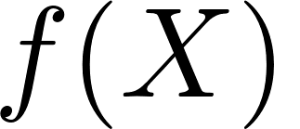

ML at 30,000 Feet
Focus on supervised learning:
At its core, supervised machine learning is about using “a set of variables” to predict “an outcome”
Var1 | Var2 | Var3 | Var4
Outcome

Slide 79
ML at 30,000 Feet
Focus on supervised learning:
At its core, supervised machine learning is about using “a set of variables” to predict “an outcome”
Var1 | Var2 | Var3 | Var4
Outcome
All of supervised ML comes down to approximating this function with high fidelity

Slide 80
What Influences Accuracy in ML?
What is accuracy?
Ability to make correct predictions on data you haven’t seen
Var1 | Var2 | Var3 | Var4
Outcome

Slide 81
What Influences Accuracy in ML?
Quantity of data
Number of distinct observations
Var1 | Var2 | Var3 | Var4
Outcome

Slide 82
What Influences Accuracy in ML?
Quantity of data
Number of distinct observations
Var1 | Var2 | Var3 | Var4
Outcome

Slide 83
What Influences Accuracy in ML?
Quantity of data
Number of distinct observations
Different characteristics about your observations
Var1 | Var2 | Var3 | Var4
Outcome

Slide 84
What Influences Accuracy in ML?
Quantity of data
Number of distinct observations
Different characteristics about your observations
Var1 | Var2 | Var3 | Var4 | Var5 | Var6 | Var7 | Var8
Outcome

Slide 85
What Influences Accuracy in ML?
Quantity of data (number of rows)
Number of features (columns)
Lots of other things!
Relevance of information to underlying phenomena
Umbrellas predict rain better than color of a person’s dress
Complexity of your model (how we approximate “f”)
Modern developments in "deep learning" allow for very complex models that were historically very hard to train
“Feature engineering”
Using domain knowledge to create new features from the input data (some of it can be automated but the analyst has a big role to play)

Slide 86


